Slide 1
The Super-curriculum at J6th
A structured way of ‘going beyond’ your subject in an academic way.
Extra-curricular
‘On top’ of the curriculum – e.g. sports activities.

Slide 2
Intellectual curiosity beyond what you are being taught in college (to pass exams!)
Desire to learn more and ask questions
Build proactive, independent and self-motivated students
curriculum (n.)
"a course, especially a fixed course of study at a college, university, or school," 1824, from a Modern Latin transferred use of classical Latin curriculum "a running course" (also "a fast chariot, racing car"), from currere "to run”.
Notes:
Exciting project
Y7 first to try it

Slide 3
Wider reading and thinking
Academic and enrichment focus
Dedicated wider reading and thinking lists
Super-curricular noticeboard and emails
Lunchtime Lectures
Future Learn courses
Other resources: Oxplore, Hay Levels, Oxford University podcasts

Slide 4
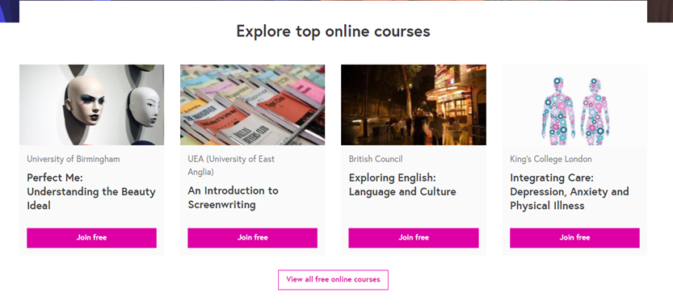
All Year 12 will be expected to attend two lectures or complete two Future Learn courses as a minimum per year. Your engagement will be discussed in your tutorials.
https://www.youtube.com/watch?v=aEyjRmCV6ck

Slide 5
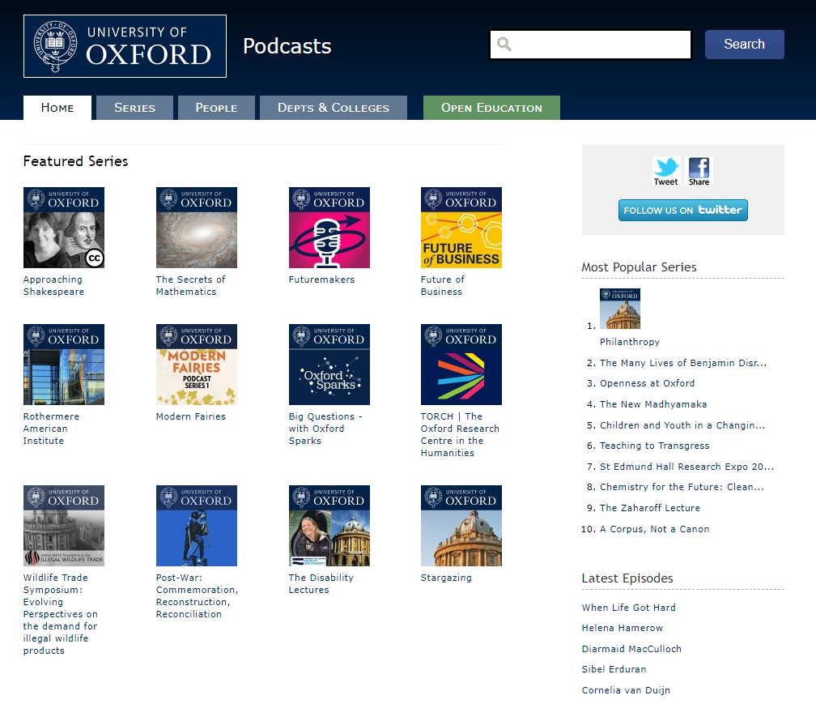
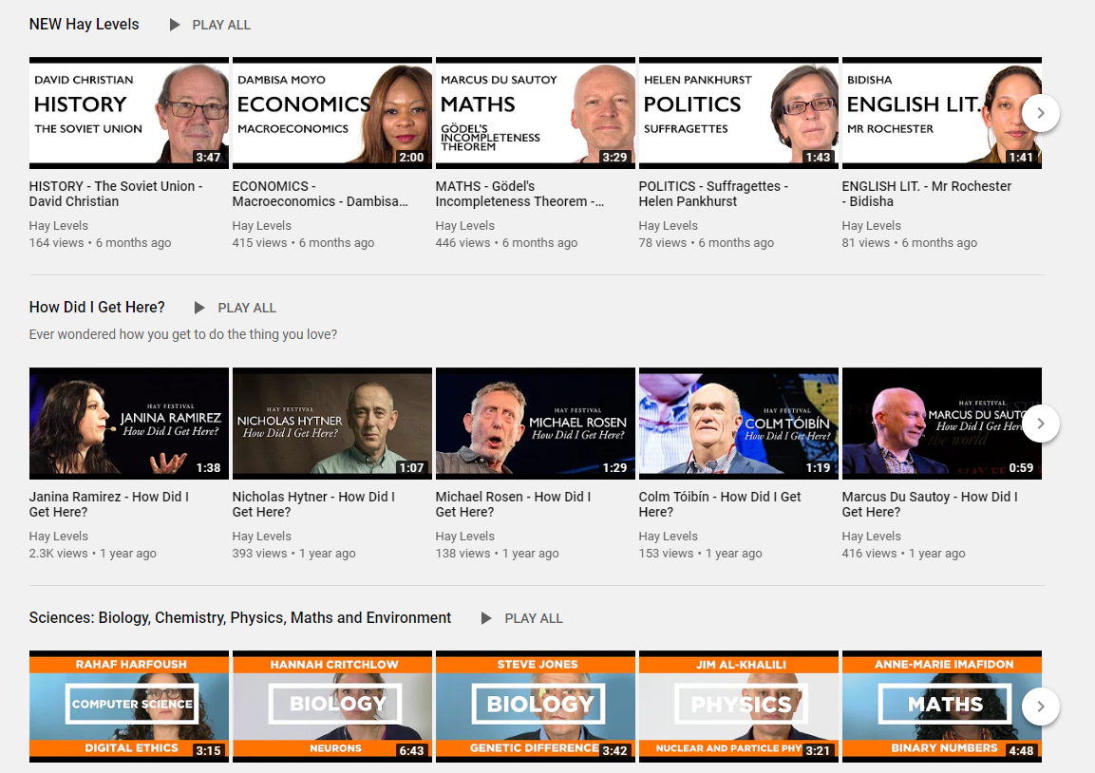

Slide 6
Every other Thursday (starting 26th September)
SF3
12:40
Thursday 26th September - Haematology
Thursday 10th October - Mary Wollstonecraft
Coming up: Maths, Victorian Literature
Check your emails for updates and sign in at the lecture as proof of attendance.

Slide 7
Debating Matters
Every other Thursday starting Thursday 3rd October in SF3
Email expressions of interest

Slide 8
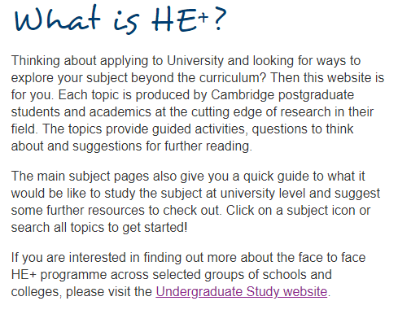
HE Plus at J6th
Y12 scheme – self-selecting, run by Cambridge University
Encourages students to ‘go beyond’ their subject in order
to make competitive University applications to high-tariff Universities
Compile a record of super-curricular engagement for personal statement

