Slide 1
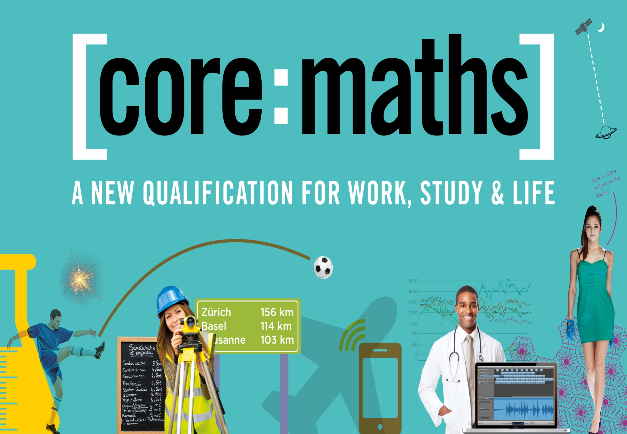

Slide 2
WHAT IS CORE MATHS?
Core Maths is a Level 3 course for students who achieve a Grade 5 or above pass at GCSE Maths. The qualification is designed to prepare students for the mathematical demands of work study and life.
It's a major part of the government's plan to increase participation post 16 and raise mathematical standards. The ambition is for the majority of students to continue studying maths until 18 years old.
The course has been developed with employers, universities and professional bodies as valuable preparation for higher education and employment.

Slide 3
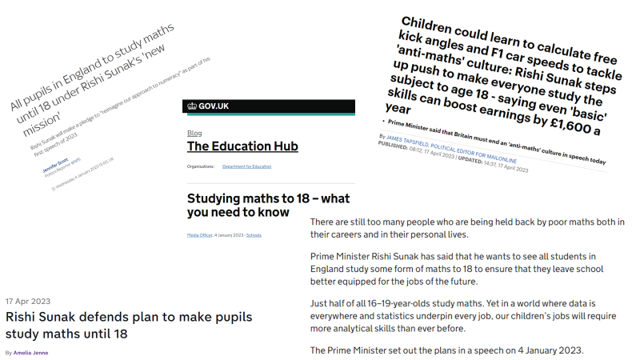

Slide 4
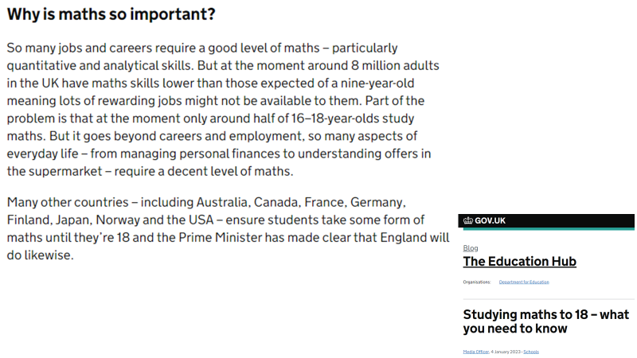

Slide 5
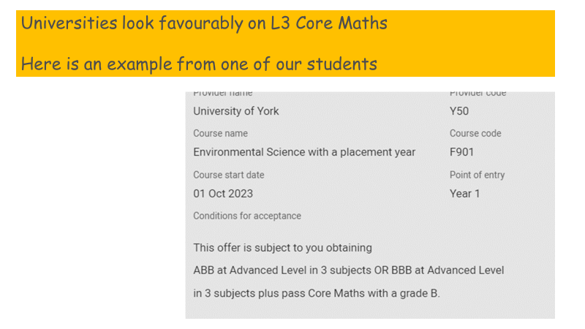

Slide 6
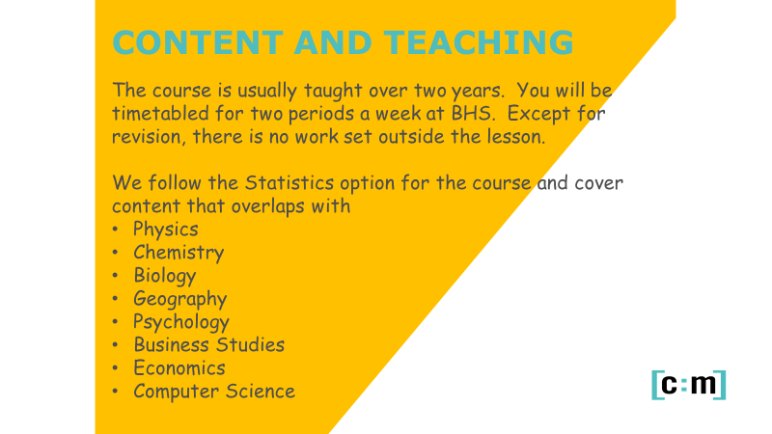

Slide 7
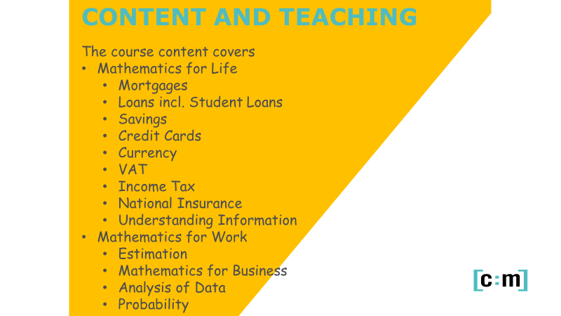

Slide 8
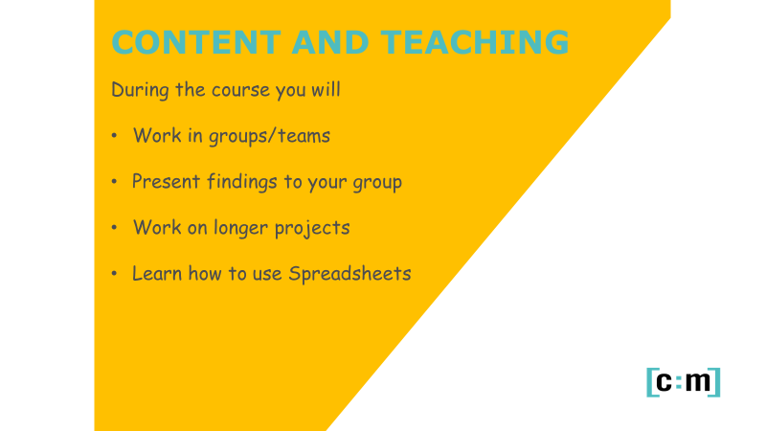

Slide 9
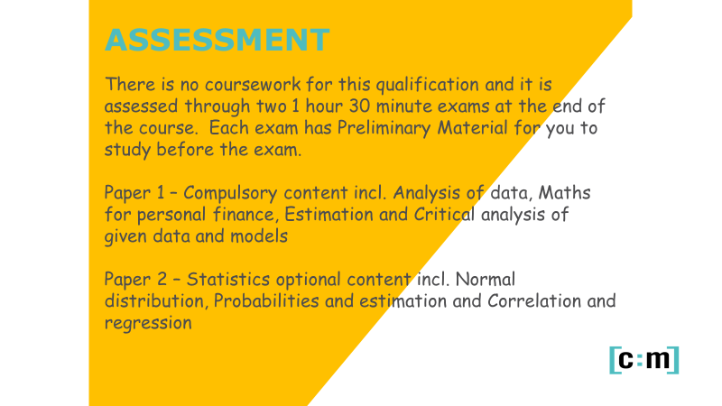

Slide 10
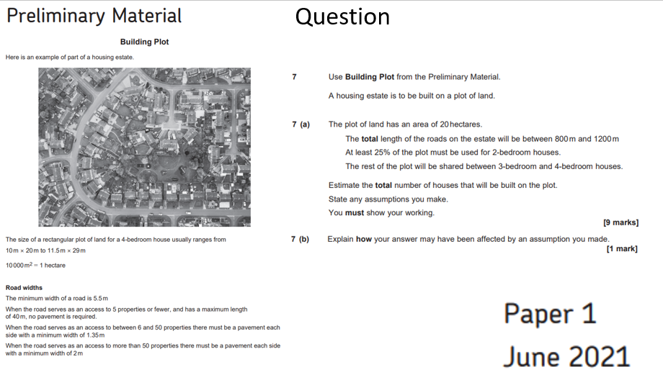

Slide 11
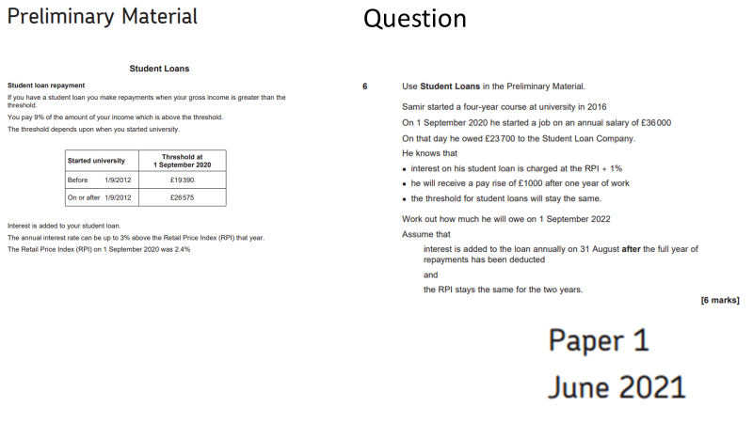

Slide 12
National Insurance
Mortgages
Credit Cards
Profit/Loss
Research
Spreadsheets
Currency
Income Tax
Student Loans
Import/Export
Notes:
The content covers a range of techniques and knowledge that will be valuable in a wide range of contexts in work, life and further study.
Emphasise the idea that Core Maths will support students taking new A-Level subjects with increased mathematical content.
The approach stresses the importance of problem solving; showing students how the mathematics they studied to GCSE (and some carefully chosen additional content) can be applied to real-world problems.

