Slide 1
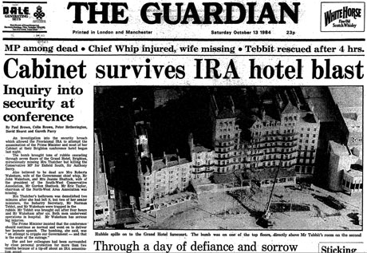
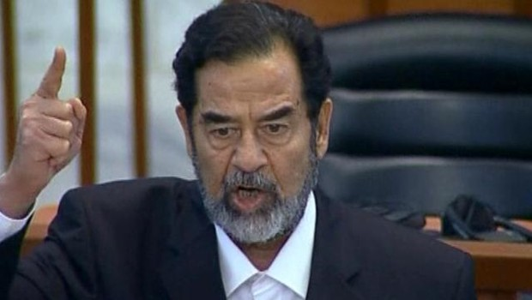
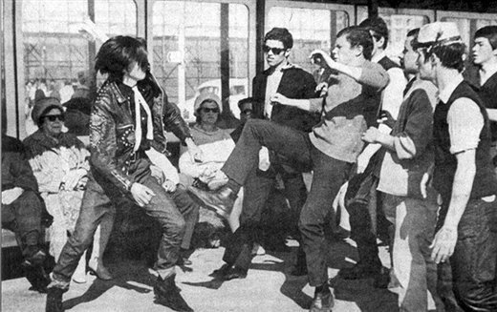
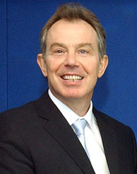
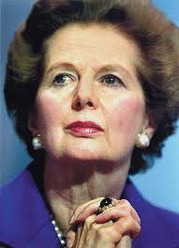
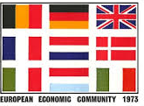
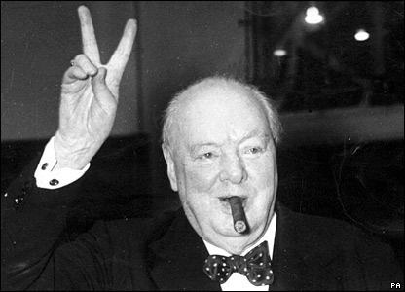
The Making of Modern Britain
1951-2007
Year 12: 1951-1979
Year 13 1979-2007
POLITICAL | ECONOMIC | SOCIAL | UK’S PLACE IN THE WORLD

Slide 2
Topics to be covered
Prime ministers
NHS
Notting Hill race riots
Mods and rockers
The Profumo affair
Suez crisis 1956
The open door policy
In Place of Strife
Issues in Northern Ireland
Rhodesia
EEC
Margaret Thatcher
The winter of discontent
The Falklands War
New Labour
7/7 bombings
The Balkans
Murder Stephen Lawrence
Iraq War
Paper is 1hr 30
You will have two questions to answer
1 compulsory source question
And
1 with 2 options

Slide 3
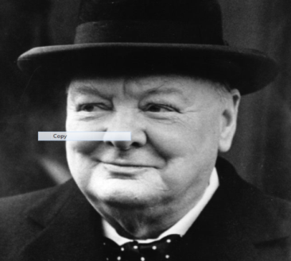
Britain in 1951 Learning Objective: What was it like to live in Britain in 1951?
Today we will examine historical sources to explain and analyse the key political, economic, social and international themes in 1951

Slide 4
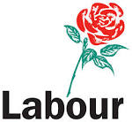
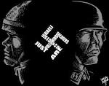
Key terms, ideologies and concepts
Left
Wing
Socialism
New Labour
Right
Wing
Communism
Labour
The centre
Conservatives
Fascism e.g Nazis
Starter – Study the political spectrum. Discuss in pairs your understanding of these key terms. Can you write down any ideas?

Slide 5
Definitions Now use this information sheet to add more key words to your political spectrum
Socialism – Political ideology characterised by state ownership rather than private ownership of the means of production. Wealth is distributed equally amongst society members
Communism – Political ideology characterised by community ownership over the means of production rather than private or state ownership. The state is abolished and workers rule themselves in small collective Soviets.
Fascism – Political ideology characterised by nationalism, racism and the belief in a superior race. Inequality permeates society
The Labour party – Political party established in 1893 by Kier Hardie to champion the rights of the working classes and sought to actively get involved in the day to day lives of people. Initially held a socialist position which it maintains in varying degrees until 1994. New Labour moved its policies and ideas to the right in order to try and dominate the centre ground in British politics
Conservatives/Conservatism – Political party established in 1834 traditionally associated with the aristocracy and ruling classes. Championed self help for the lower classes, held a laissez faire attitude to politics and believed in government changing very little. Market forces and free enterprise determine the living standards of the population

Slide 6
Groups
Group 1
Harry Ballard
James Evison
Chloe Dunnachie
Ruby Judson
Sui Wong
Group 2
Jessica Leigh
Lydia Pickering
Jake Farrell
Greg Johnson
Amy Dixon
Group 3
Freya Thornly
Molly Robinson
Jess Pashby
Robert Moyse
Ben Murdoch
Joanna Koszyk
Group 4
Alex Pindar
Rachel Roy
Abby Prince
Harvey Broughton
Rachel Waller

Slide 7
Groups
Theme 1: Political | Theme 2: Economic | Theme 3: Social | Theme 4: Britain’s Place in the world
As a group you will examine sources relating to one of the four different key themes
You have 10 minutes to make a poster on what you believe to be the important ideas, let your reading and notes be guided by the key questions on the worksheets.
CHALLENGE: Try to write no more than 50 words the rest of the notes have to be recorded as pictures, symbols or diagrams. Your information sheet will be taken off you after 10 minutes, so you need to be quick and get as much information onto your poster as possible.
e.g. if the information sheet says Britain was burdened with massive debts after WWII you could draw £££ ☹
Pictures do not have to be beautiful – just good enough to remind you of what you mean

Slide 8
Market Stall
You are now going to use your poster to set up a ‘market stall’.
One of you will be the talker and will stay at your ‘market stall’ to explain your poster to other pupils.
One of you will be the walker and will walk around the class, going to the other ‘market stalls’ and looking at others posters and completing your worksheet.
You have 15 minutes and 3 ‘market stalls’ to visit – so spend no more than 5 minutes at each market stall.
Skills:
Describe
Explain
Analyse
Walkers and Talkers:
Get back together and complete your work sheets!
POLITICAL | ECONOMIC | SOCIAL | UK’S PLACE IN THE WORLD

Slide 9
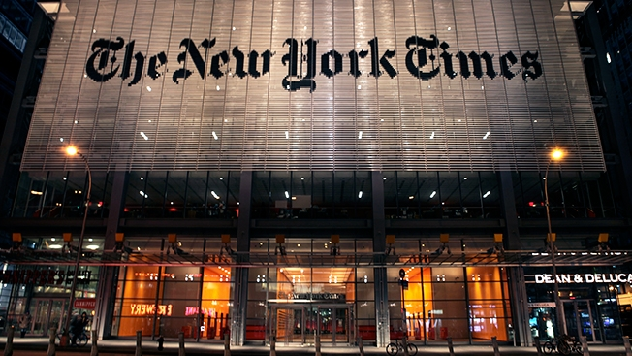
Review: What was life like in Britain in 1951?
Literacy:
You are a British journalist writing for the New York Times. The newspaper are doing features about the year 1951 as it was the year the first colour TV broadcast from the Empire State building.
Your editors has asked you to write a 200 WORD ARTICLE all about what life is like in Britain in this year.
Aim: try to write ANALYTICALLY about all the four key themes we have investigated today. Try to focus on using lots of subject specific vocab and new words you have learnt today:
Develop suitable headline to accompany your article

Slide 10
ILT
Winston Churchill
Research and find sources that give a positive and negative impression of W C.
Try to come up with an overall judgement.

